Slide 1
Session No: CO1
Session Topic: Data Modelling
DATABASE MANAGEMENT SYSTEM
(Course code: )

Slide 2
Session Objective
An ability to understand that what methods/techniques used for data modelling.
An ability to compare and evaluate different data modelling techniques.
Data Modelling: ER Model, Notation used in ER Diagram, Constraint, Types,Relationships in ER Model and other considerations in designing ER diagram. Enhanced, ER data Model, EER Diagram, Relational Model: concepts, constraints, schemas, ER to Relational Model

Slide 3
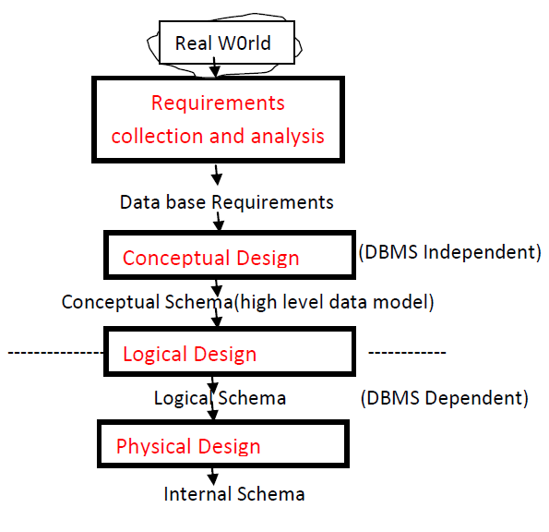
Data base design process

Slide 4
Entity Relationship Model (ER Model)
Conceptual (high-level, semantic) data models
ER modeling: A graphical technique for understanding and organizing the data independent of the actual database implementation

Slide 5
What is Entity?
ER Model concepts
Entity is an object in real world which has independent existence.
Example: Student, Course, Faculty, Car, House, College, Book, Food
ER Diagram Notation for Entity: Rectangle
Student
Courses
Also known as Entity Type

Slide 6
What is Attribute ?
Attribute is a property that describes Entity.
Attributes:
USN, Name, Email ID,
Mobile Number, DOB
Student
Entity Type
USN | Name | Email ID | Mobile No. | DOB
1BM14CS001 | Aditya | aditya@bmsce.ac.in | 9448444160 | 1-1-1997
1BM14CS002 | Bharath | bharath@bmsce.ac.in | 8762244699 | 31-12-1996
ER Diagram Notation for Attribute: Ellipse
USN
Name

Slide 7
Domain of Attribute
Set of permitted values for an Attribute.
Ex : Domain of USN= {190030001, 190030002,…..}
Domain of EmpID= {00001..10000}

Slide 8
ER Diagram notation for Entity and Attributes
DOB
Name
Address
E#
Designation
Employee
Notes:
Represented by ellipses connected to the entity type by straight lines

Slide 9
What is Entity Instance?
Entity instance: a particular member of the entity type e.g. a particular student
Student
Entity Type
USN | Name | Email ID | Mobile No. | DOB
1BM14CS001 | Aditya | aditya@bmsce.ac.in | 9448444160 | 1-1-1997
1BM14CS002 | Bharath | bharath@bmsce.ac.in | 8762244699 | 31-12-1996
Entity instance

Slide 10
Simple vs composite attribute
Simple attribute: cannot be divided into simpler components
E.g Eno. of an employee
Composite attribute: can be split into components
E.g Address of an employee.
Can be split into D.No., street, city, pincode
ENo
street
City
D.No
pincode
Address

Slide 11
ER with Composite attribute
city
street
D.No.
DOB
pincode
Name
Address
E#
Designation
Employee
Notes:
Represented by an ellipse from which other ellipses emanate and represent the component attributes. E.g Address

Slide 12
Single Vs Multi-valued Attributes
Single valued : can take on only a single value for each entity instance
E.g. age of employee. There can be only one value for this
Multi-valued: can take many values
E.g. skill set of employee ,car number/colour, phone number

Slide 13
Multivalued Attribute
DOB
Address
Name
Designation
E#
Employee
skill set
Notes:
Indicated by a double lined ellipse as shown in the figure

Slide 14
Stored Vs Derived attribute
Stored Attribute: Attribute that need to be stored permanently.
E.g. name of an employee, Dob
Derived Attribute: Attribute that can be calculated based on other attributes
E.g. : age of an employee based on DOB and current date
years of service based on the date of joining and current date

Slide 15
Key Attribute
Key attribute is an attribute or a combination of attributes which will uniquely identify remaining attributes of entity.
What are the Key attributes in the following student table ?
USN | Name | Email ID | Mobile No. | DOB
1BM14CS001 | Aditya | aditya@bmsce.ac.in | 9448444160 | 01-01-1997
1BM14CS002 | Bharath | bharath@bmsce.ac.in | 8762244699 | 31-12-1996
1BM14CS003 | Bharath | bharath9@bmsce.ac.in | 8762244699 | 31-12-1996
ER Diagram Notation for key attribute: underline attribute
USN
Mobile No.
Email ID

Slide 16
Regular Vs. Weak entity type
Regular Entity: Entity that has its own key attributes.
E.g.: Employee, student ,customer, policy holder etc.
Weak entity: Entity that depends on other entity for its existence and doesn’t have key attribute of its own
E.g. : spouse of employee
The spouse data is identified with the help of the employee id to which it is related
Notes:
The spouse data is identified with the help of the employee id to which it is related

Slide 17
What is COMPOSITE Key ?
What are the Key attributes in the following student table ?
Faculty Name | Department | Salary
A | CSE | 20K
B | CSE | 20K
A | EC | 30K
B | EC | 27K
C | CSE | 22K
composite key : Combination of Two or More attributes
In the example, Faculty Name & Department together is a Composite key

Slide 18
ER Diagram notations
Attribute
…..
Composite Attribute
Multivalued Attribute
Derived Attribute
Entity
______
Key Attribute

Slide 19
Group activity
We will move you into breakout rooms for 10 minutes
Introduce each other quickly
Appoint a time keeper and recorder
Answer the following
create an entity of your choice with all the attributes discussed so far.
Should not use the example entities discussed in the lecture

Slide 20
Relationship
The association between entities is called a relationship.
relationship
Enrolls_for
Student
Course

Slide 21
Relationship - example
Avinash
Balaji
Chandan
Dinesh
DBMS
Java
Student
Entity
enrolls_for
relationship
Course
Entity

Slide 22
Relationship Type
A relationship type between two entities defines the set of all associations between these entities
relationship
Works_for
Faculty
Department
Enrolls_for
Student
Course

Slide 23
Relationship Type- example
Avinash
Balaji
Chandan
Dinesh
DBMS
Java
Student
Entity
enrolls_for
relationship
Course
Entity

Slide 24
Relationship instance
Each instance of the relationship between members of these entity types is called a relationship instance
Dr. Guruprasad
Dr. Umadevi
Dr. Indiramma
Dr. Ashok
CSE
ISE
Faculty
Entity
Department
Entity
Works_for
relationship

Slide 25
Relationship Set
An Relationship Set is a collection of relationships all belonging to one relationship type.
Here relationship set, has 4 relationships
Avinash
Balaji
Chandan
Dinesh
DBMS
Java
Student
Entity
enrolls_for
relationship
Course
Entity

Slide 26
Relationship Degree
The degree of a relationship is the number of entity types that participate(associate)in a relationship.
Unary Relationship: Degree One, a entity is related to the same . Also known as recursive.
Binary Relationship: Degree Two, an entity is related to another entity
Ternary Relationship: Degree Three, three entities are participating

Slide 27
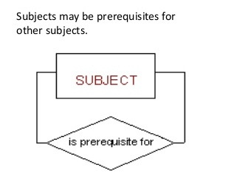
Unary Relationship - example
Unary Relationship: Degree One, a entity is related to the same.. ((Recursive relationship)

Slide 28
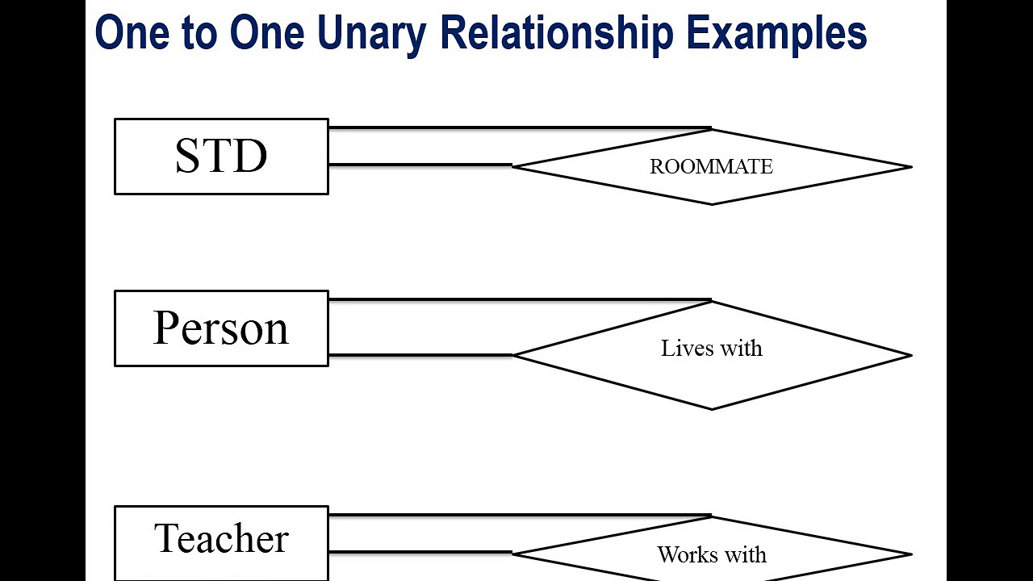

Slide 29
Unary (Recursive) Relationship
In some cases the same entity type participates in more than once in a relationship type in different roles.
Dr. Guruprasad
Dr. Umadevi
Dr. Indiramma
Supervisor
Subordinate
Subordinate
Faculty
Entity
supervision
relationship

Slide 30
Recursive Relationship
In some cases the same entity type participates in more than once in a relationship type in different roles.
Subordinate
Dr. Guruprasad
Dr. Umadevi
Dr. Indiramma
Principal
Supervisor
Supervisor
Faculty
Entity
supervision
relationship

Slide 31
Binary Relationship example
Binary Relationship: Degree Two, an entity is related to another entity
Dr. Guruprasad
Dr. Umadevi
Dr. Indiramma
Dr. Ashok
CSE
ISE
Faculty
Entity
Works_for
relationship
Department
Entity

Slide 32
Ternary Relationship -example
Ternary Relationship: Degree Three, three entities are participating
Micro Systems Pvt. Ltd
UNIQ systems
Pvt. Ltd
Laptop
Manufacturing
Desktop
Manufacturing
Supplier
Entity
Hard disk
Keyboard
supplies
relationship
Project
Entity
Part
Entity

Slide 33
Ternary Relationship -Example
Micro Systems Pvt. Ltd
UNIQ systems
Pvt. Ltd
Laptop
Manufacturing
Desktop
Manufacturing
Supplier
Entity
Hard disk
Keyboard
supplies
relationship
Project
Entity
Part
Entity

Slide 34
Relationship Constraints or Structural Constraints
Two Types of Relationship Constraints
Cardinality Ratios
One to one (1:1)
One to Many (1:M)
Many to Many (N:M)
Participation Constraints
Total
Partial

Slide 35
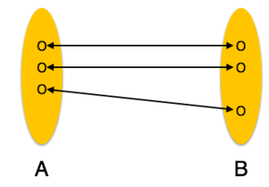
Cardinality Ratios
Cardinality is a constraint on a relationship specifying the number of entity instances that a specific entity may be related to via the relationship.
One to One:
One entity from entity set A can be associated with at most one entity of entity set B and vice versa.

Slide 36
Cardinality – One to one
Faculty
Heads
Department
1
1

Slide 37
Cardinality Ratios One to One
Example
Dr. Guruprasad
Dr. Gowrishankar
CSE
ISE
Faculty
Entity
Department
Entity
Heads
relationship

Slide 38
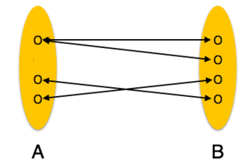
Cardinality Ratios One to Many
One to Many:
One entity from entity set A can be associated with more than one entities of entity set B however an entity from entity set B, can be associated with at most one entity.
Entity A
R
Entity B
1
M

Slide 39
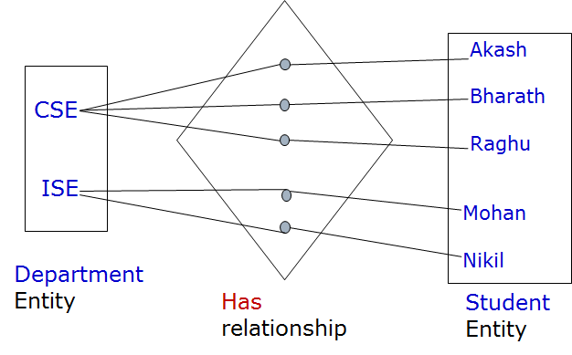
Cardinality One to Many
Example
Department
1
Has
M
Student

Slide 40
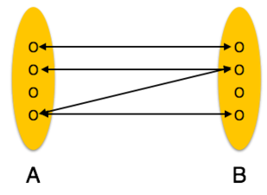
Cardinality Many to Many
Many to Many:
One entity from A can be associated with more than one entity from B and vice versa.
Entity A
N
R
M
Entity B

Slide 41
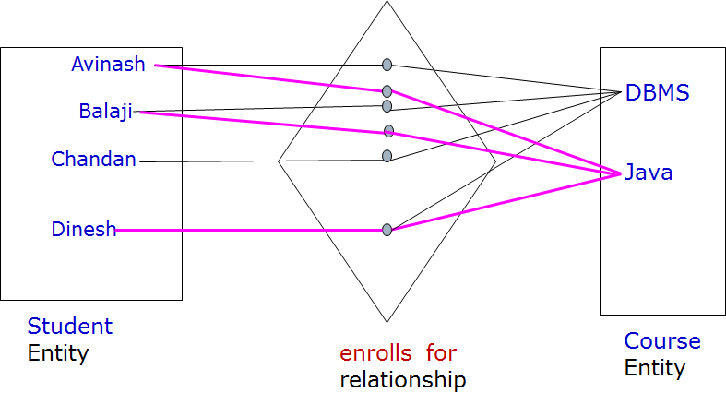
Cardinality Many to many
Example

Slide 42
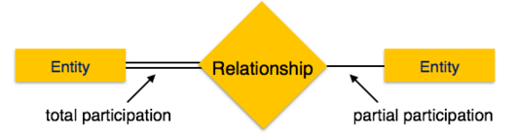
Participation Constraint
Minimum number of relationship instance that each entity can participate in.
Total Participation − Each entity is involved in the relationship. Total participation is represented by double lines.
Partial participation − Not all entities are involved in the relationship. Partial participation is represented by single lines.

Slide 43
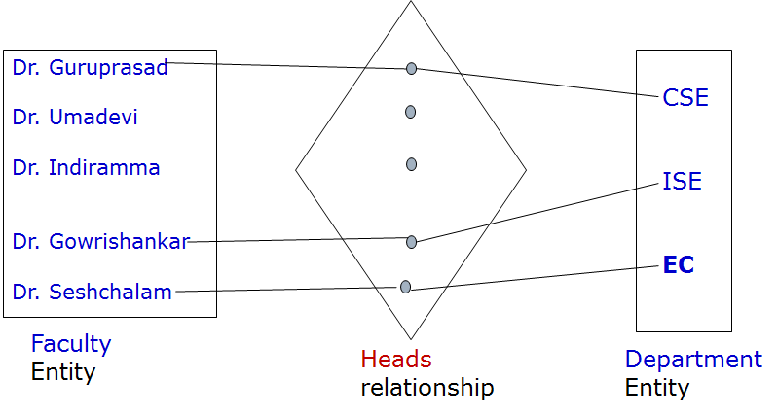

Participation Constraint
Example

Slide 44


ER Diagram Symbols
Relationship
Total Participation of Entity A in R
Cardinality Ratio 1:N for Entity A : B in R

Slide 45
Exercise- Draw an ER diagram
A popular car service centre wanted maintain the complete information about their customers and serviced cars. Car manufacturer makes different model cars and sell to various customers. Customer owns one or more cars with same or different companies. Customer approaches XYZ car service centre for repair. Service centre assign a mechanic for the repairs cars belongs to customer. After the service customers will be charged.

Slide 46
